Slide 1


MACHINE LEARNING: Book Recommendation System
Rosemary Medina-Casanova

Slide 2
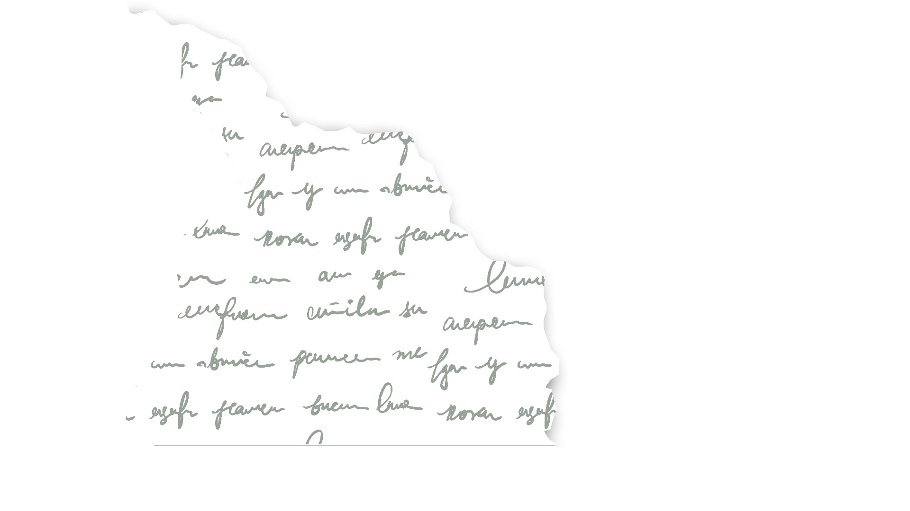
Table of Contents
Business Case
Contents of Data
Feature Engineering
SVD & Collaborative Filtering
Model Selection
Model Evaluation
Recommendation System
Insights/Improvements

Slide 3
Business Case
Goodreads hired me to create a book recommendation system, using data from an API, to provide their customers with a more personalized experience.

Slide 4
Contents of the Data
This project implements a book recommendation system using collaborative filtering with the Surprise library. The project includes feature engineering, model training, evaluation, and visualizations.
Requirements | Python, pandas, scikit-learn, surprise, matplotlib, seaborn, streamlit
Data Used | Two datasets were collected from Goodreads (API – scraped)
Data Cleaning & Preprocessing | Drop columns & null values, defined chunk size, added genre column, converted data types for features
Machine Learning | Model Training (SVD), Model Evaluation (MAE, R2, RMSE), Model Selection (Surprise, Train/Test Split), Collaborative Filtering
Feature Engineering | Avg Rating, MinMaxScaler

Slide 5
Feature Engineering
These are some of the steps I took in preparing the data for Model Selection & Evaluation
Data Type Conversion Ensured that data was in a format that could be easily processed by the recommendation algorithm, improving the efficiency of the model training process.
Feature Normalization The numerical features, such as ratings, were normalized to ensure that all features contribute equally to the model's predictions.
Sparse Matrix Conversion The user-item matrix was inherently sparse due to many users not rating many books. The Surprise library handles this by converting the user-item matrix into a sparse matrix representation, which is more efficient for handling large datasets with many missing values.

Slide 6
SVD & Collaborative Filtering
SVD was used to perform collaborative filtering by decomposing the user-item interaction matrix.
Collaborative Filtering
Collaborative filtering is a method used to make automatic predictions about the interests of a user by collecting preferences from many users.
Example: If person A has the same opinion as person B on an issue, A is more likely to have B's opinion on a different issue than that of a randomly chosen person.
Singular Value Decomposition (SVD)
SVD is a matrix factorization technique used in collaborative filtering. It decomposes the user-item interaction matrix into three matrices, capturing the underlying structure of the data. This technique helps in reducing the dimensionality of the data and finding latent factors that explain observed interactions.
The basic idea is to represent both users and items in a lower-dimensional space of latent factors, which can be used to predict the missing entries in the user-item matrix.

Slide 7
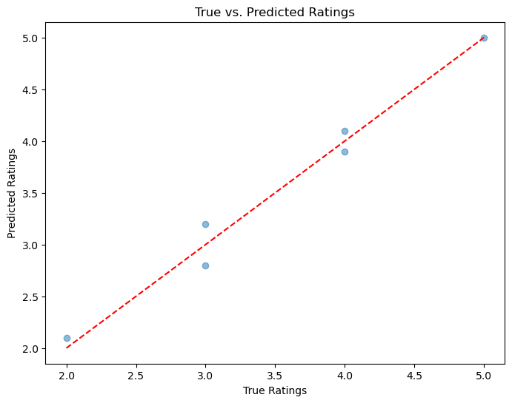
Model Selection
Algorithm Choice (SVD):
Selected for its ability to handle sparse matrices and uncover latent factors.
Data Preparation:
Prepared data using the Surprise library's Reader and Dataset.
Model Training:
Leveraging the surprise library to implement SVD; trained the SVD model on the user-item interaction matrix.
Prediction and Evaluation:
Generated predictions to evaluate model performance.

Slide 8
0.6594712259028492
0.20435451028367524
0.8436022074893497
Model Evaluation
MEAN ABSOLUTE ERROR (MAE)
R-SQUARED (R2)
ROOT MEAN SQUARED ERROR (RMSE)

Slide 9
Streamlit Integration
Recommendation System
User Input
Model Deployment
Output
_______________
_______________
_______________
The system takes a User’s ID as input, representing their unique identity within the dataset
The trained recommendation model was deployed using Streamlit, enabling users to access and interact with the system directly.
The output lists book recommendations (1-20), including title, author, and average rating, tailored to the User's profile.
Integrating Streamlit with the recommendation system allowed me to create an interactive web application where users can input their preferences and receive real-time book recommendations.

Slide 10

Insights/Improvements
Insights: The book recommendation system creates a more personalized experience, leading to boosted sales, increased engagement, and enhanced user experiences.
Improvements: Collect accurate genre data to improve the accuracy and relevancy of the recommendations.

Slide 11
THANK YOU!
daddy, chill

